Slide 1
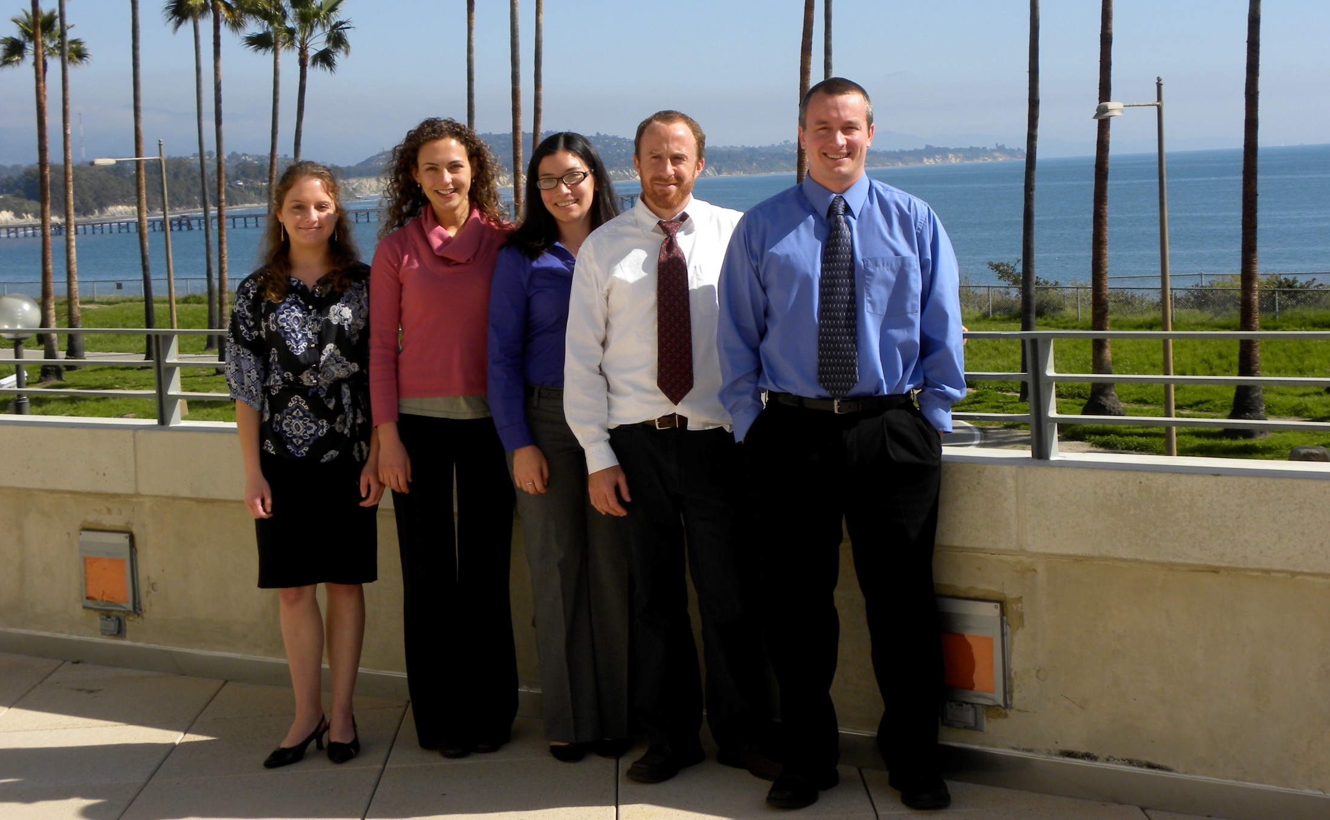
Progressive Water Solutions
Innovative Market Solutions for Efficient Groundwater Management
Notes:
Thank you for coming to our presentation. We are progressive Water Solutions, or PWS. Our group members are Zoe Carlson, Alex Speers, Dan Crocker, Matt Young, and I am Sara Solis. Our faculty advisor is Gary Libecap.

Slide 2
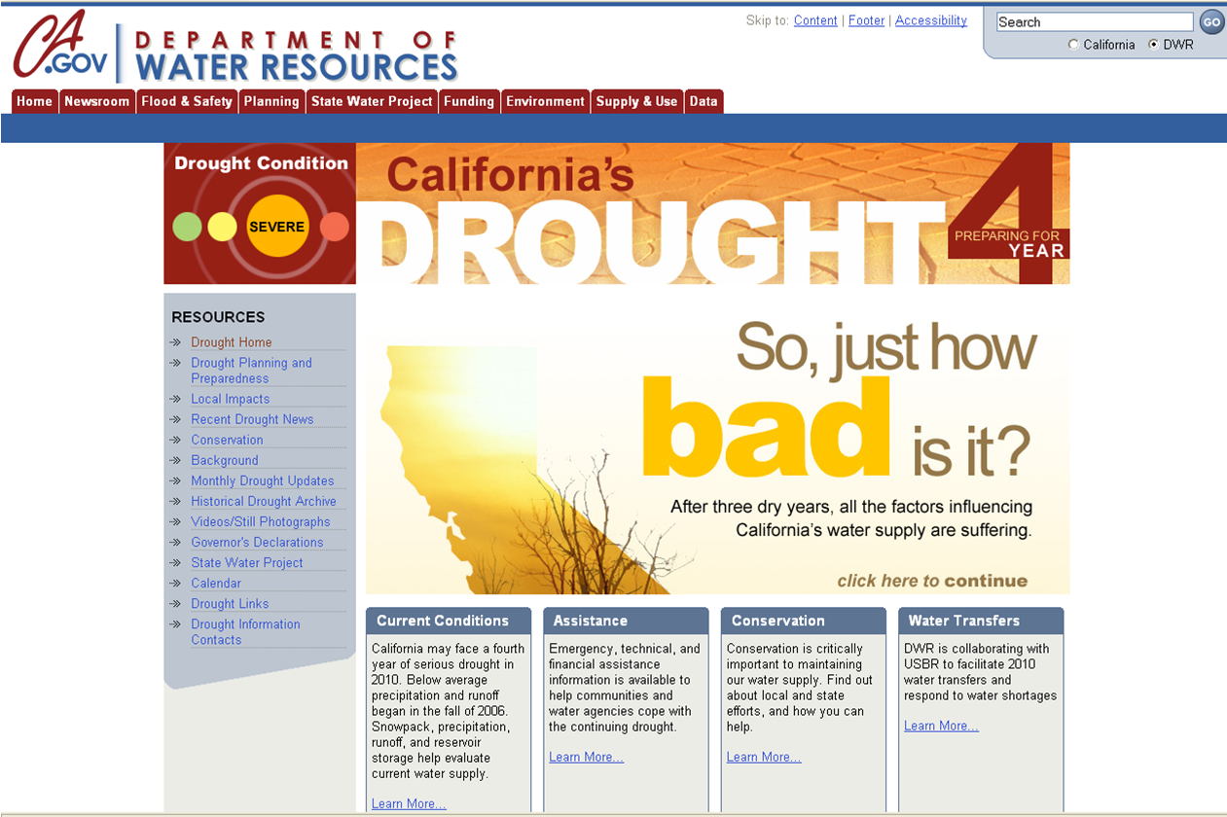
Notes:
Mark Twain is credited with saying, “Whiskey is for drinking, water is for fighting over.” This quote holds especially true in California. In this state we’ve experienced 3 consecutive years of drought, ***
and despite recent rains, we are possibly entering a 4th year. Water users ranging from farmers to cities to water management agencies are battling to secure enough water to meet their needs. I just read about a survey gauging how much people know about where there water comes from. Most Southern Californians replied that their water comes from…

Slide 3
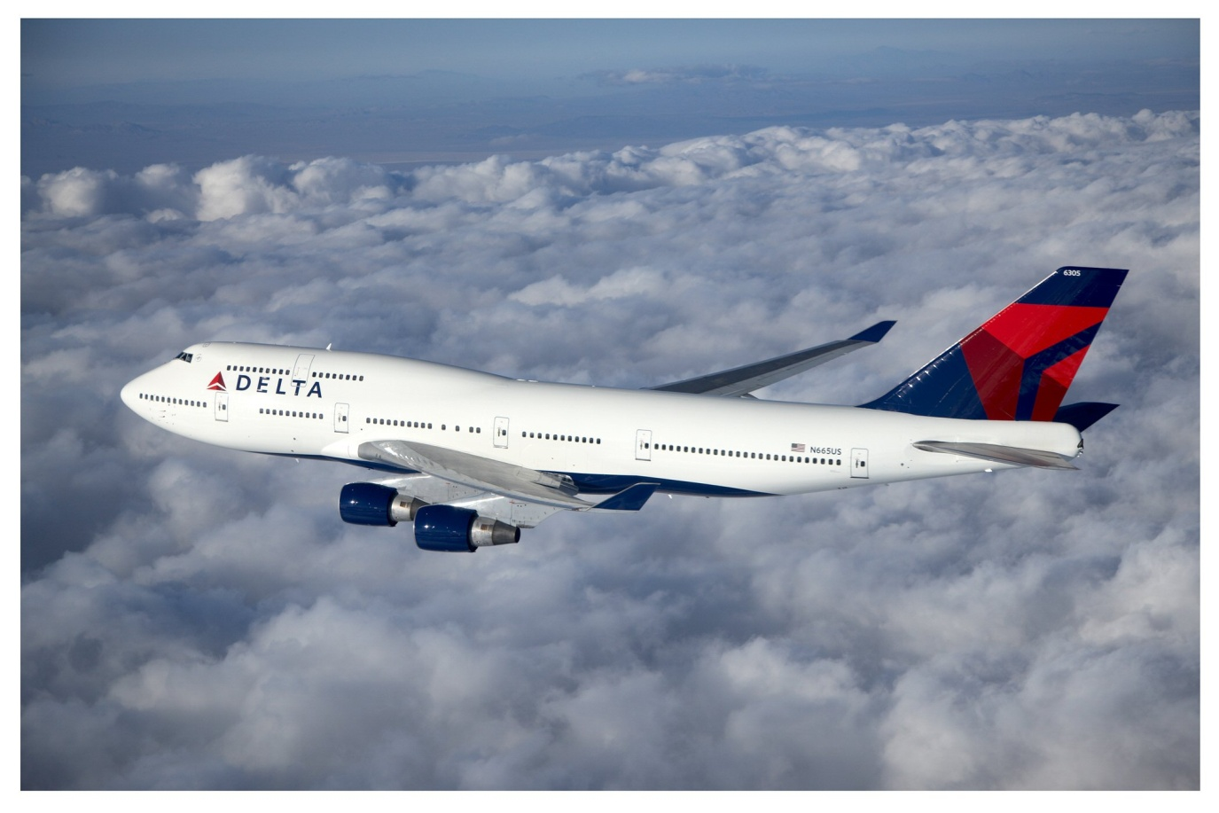
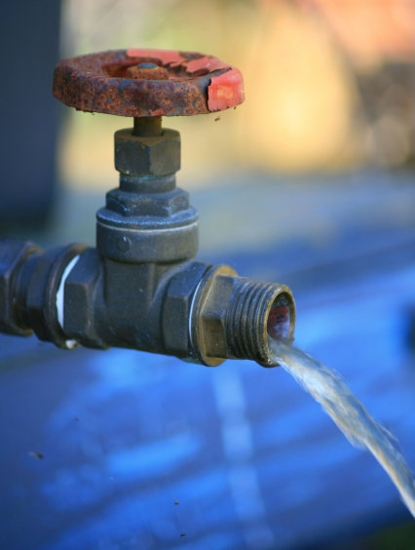
©2010 Delta Air Lines, Inc.
Image: Simon Howden / FreeDigitalPhotos.net
Notes:
the tap. This is not quite accurate. When asked whether they’d heard of the Delta, meaning the Sacramento-San Joaquin Delta, which is the source of much of Southern California’s water, the most popular response was *** “airline.” This is also inaccurate. So just in case we have any of those survey respondents in the audience today, I’ll provide a bit of background on our water resources in California.

Slide 4
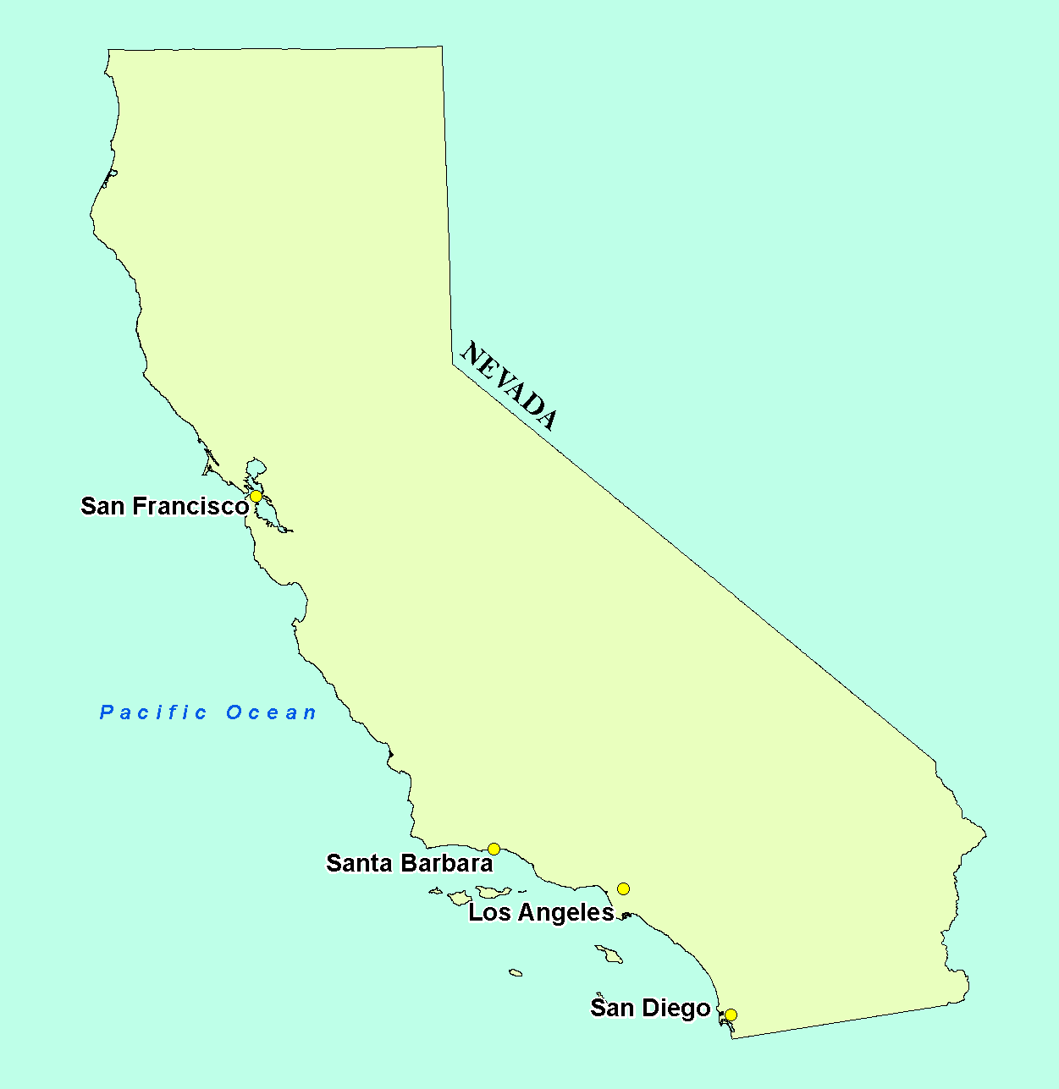
Notes:
2/3 of our water is used in the southern half of the state, but 2/3 of the precipitation falls in the northern half of the state. So, we have the most complex and expensive water storage and distribution system in the world to move water from its source to where it is demanded…

Slide 5
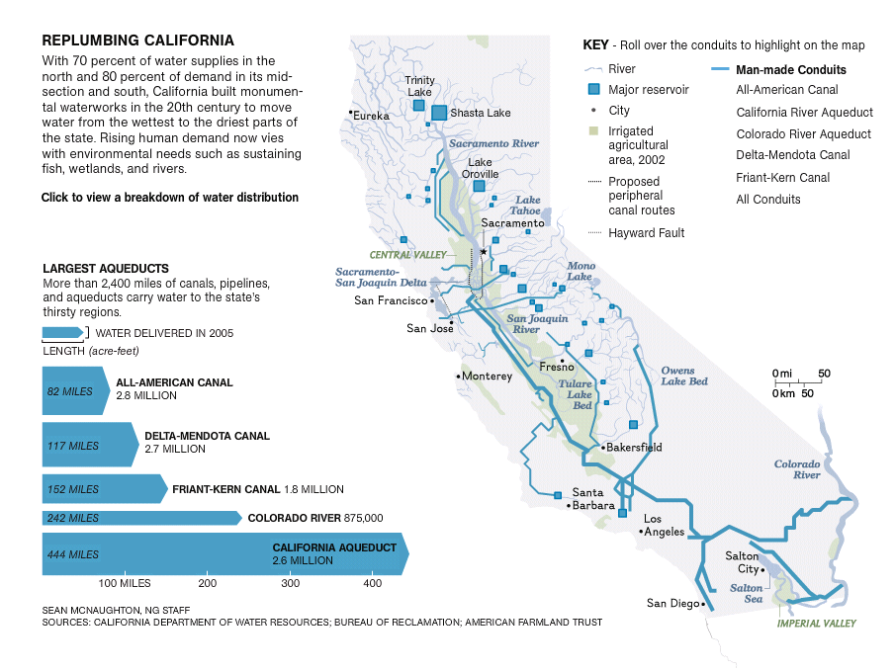
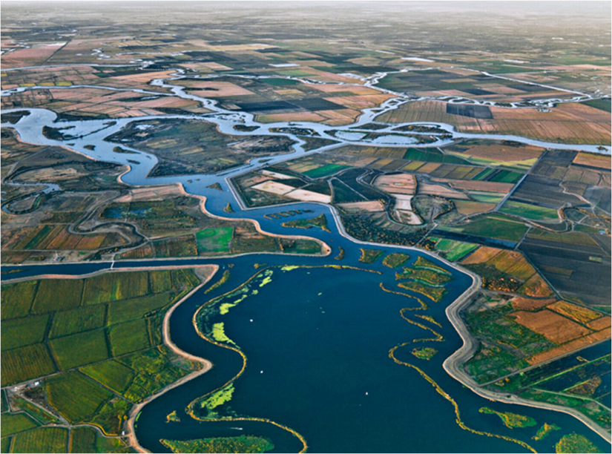
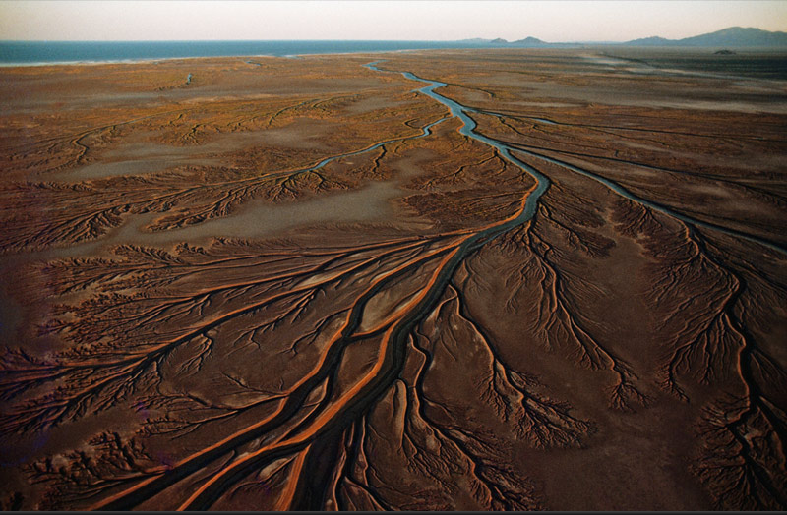
Image: Edward Burtynsky / National Geographic 2010
Image: Sean McNaughton / National Geographic 2010
Image: Annie Griffiths Belt / National Geographic 2008
Notes:
shown in this image from National Geographic. This transport has a lot of negative impacts. One example is the movement of water through the strained Sacramento-San Joaquin Delta, which is not an airline but the junction of the Sacramento and San Joaquin rivers near San Francisco.*** The Delta’s natural waterways have been altered to an extreme degree, and the fish populations there have been decimated. Another example is diversions from the Colorado River.*** So much water has been taken from the river that it no longer reaches the ocean. The communities and ecosystems that have lost those river flows have experienced severe water stress. Additionally, the energy and infrastructure needed to move all this water is extremely expensive.
So those are our imported water sources. We also have a local water source in groundwater.

Slide 6
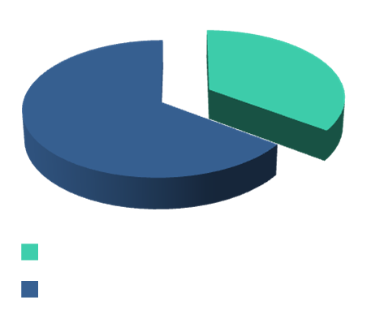
Notes:
GW is water that percolates through the soil and is stored in underground aquifers. These aquifers are generally confined in geographical units by impermeable rock or soil, and these units and the land overlying them are referred to as “gw basins.” ***GW satisfies about 30% of California’s water needs in average years, and over 40% in drought years. The problem with GW is it is often over-used. California water law basically allows anyone with a well to pump as much groundwater as they want, as long as they put it to “beneficial use. If too much GW is pumped, the aquifer is depleted, and a condition called “GW overdraft” ensues. Overdraft has a host of negative consequences…

Slide 7
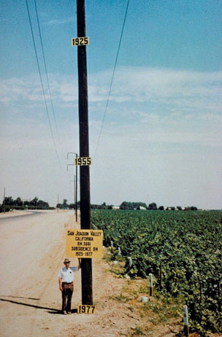
Land Subsidence
1925
1977
Image: Joseph F. Poland / U.S. Geological Survey
Notes:
There’s land subsidence (like this example from the San Joaquin Valley, where the land subsided 9 meters in about 50 years)…

Slide 8
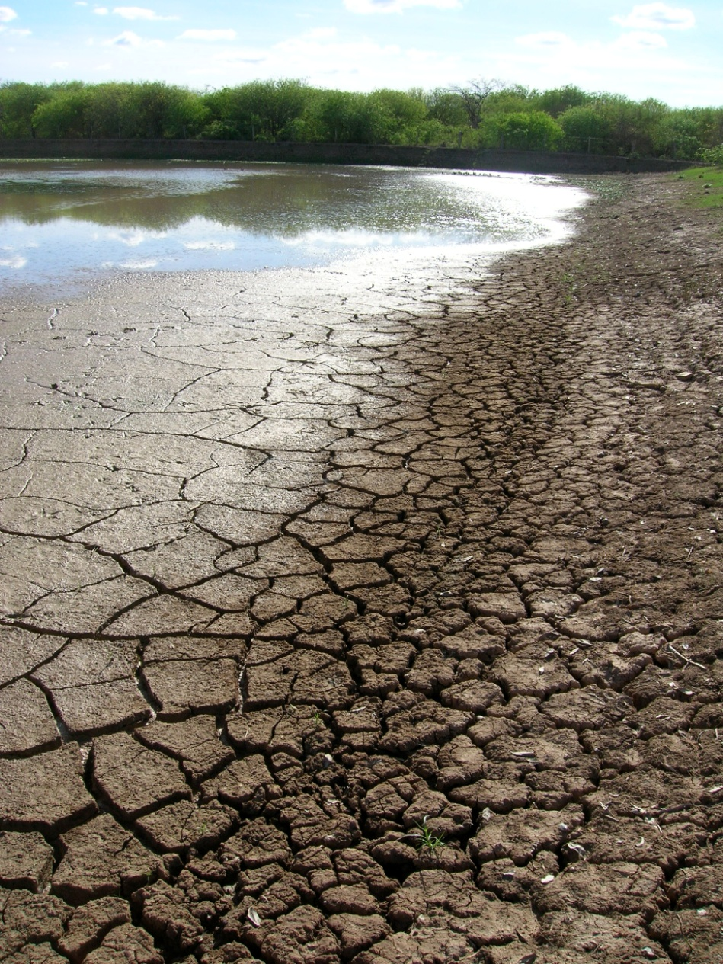
Reduced surface flows
http://www.californiagroundwater.org/basinsmap.htm
Notes:
reduced surface flows (like this dried-up pond)…

Slide 9
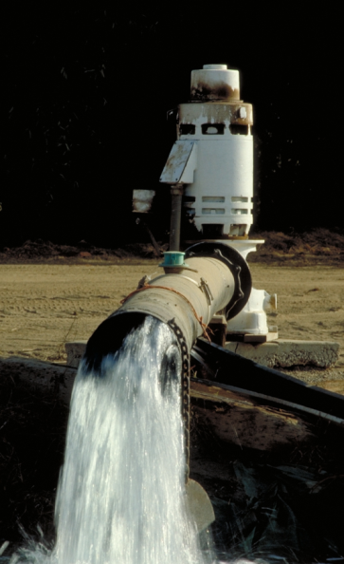
Increased Pumping Costs
http://www.californiagroundwater.org/basinsmap.htm
Notes:
higher pumping costs for well owners to pump from greater depth…

Slide 10
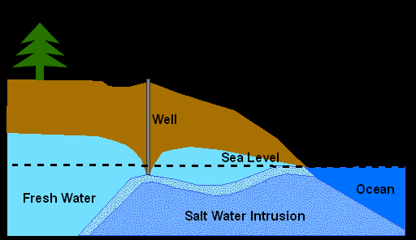
http://www.californiagroundwater.org/basinsmap.htm
Notes:
And seawater intrusion along the coast that impairs groundwater quality.

Slide 11
Adjudication
Defines individual rights
Limits groundwater pumping
Defines individual rights
Establishes a Watermaster
Notes:
Currently, the most effective regulatory tool to limit groundwater overuse and overdraft is adjudication. "Adjudication" is a legal process by which a court *** limits the total amount of groundwater that can be pumped annually in a basin to the “safe yield,” which is the amount that will not result in overdraft. The court then *** defines the groundwater pumping rights of all the individual users in the basin by allocating some portion of that total safe yield to each user. The rights allocation is generally based on historical pumping by each user. The court also *** appoints a Watermaster, which is a person or entity responsible for managing extractions, storage, and transfers, and enforcing of the terms of the adjudication.
The adjudication process is often contentious, lengthy, and expensive. Adjudications in California have taken as long as 26 years and often cost millions of dollars.

Slide 12
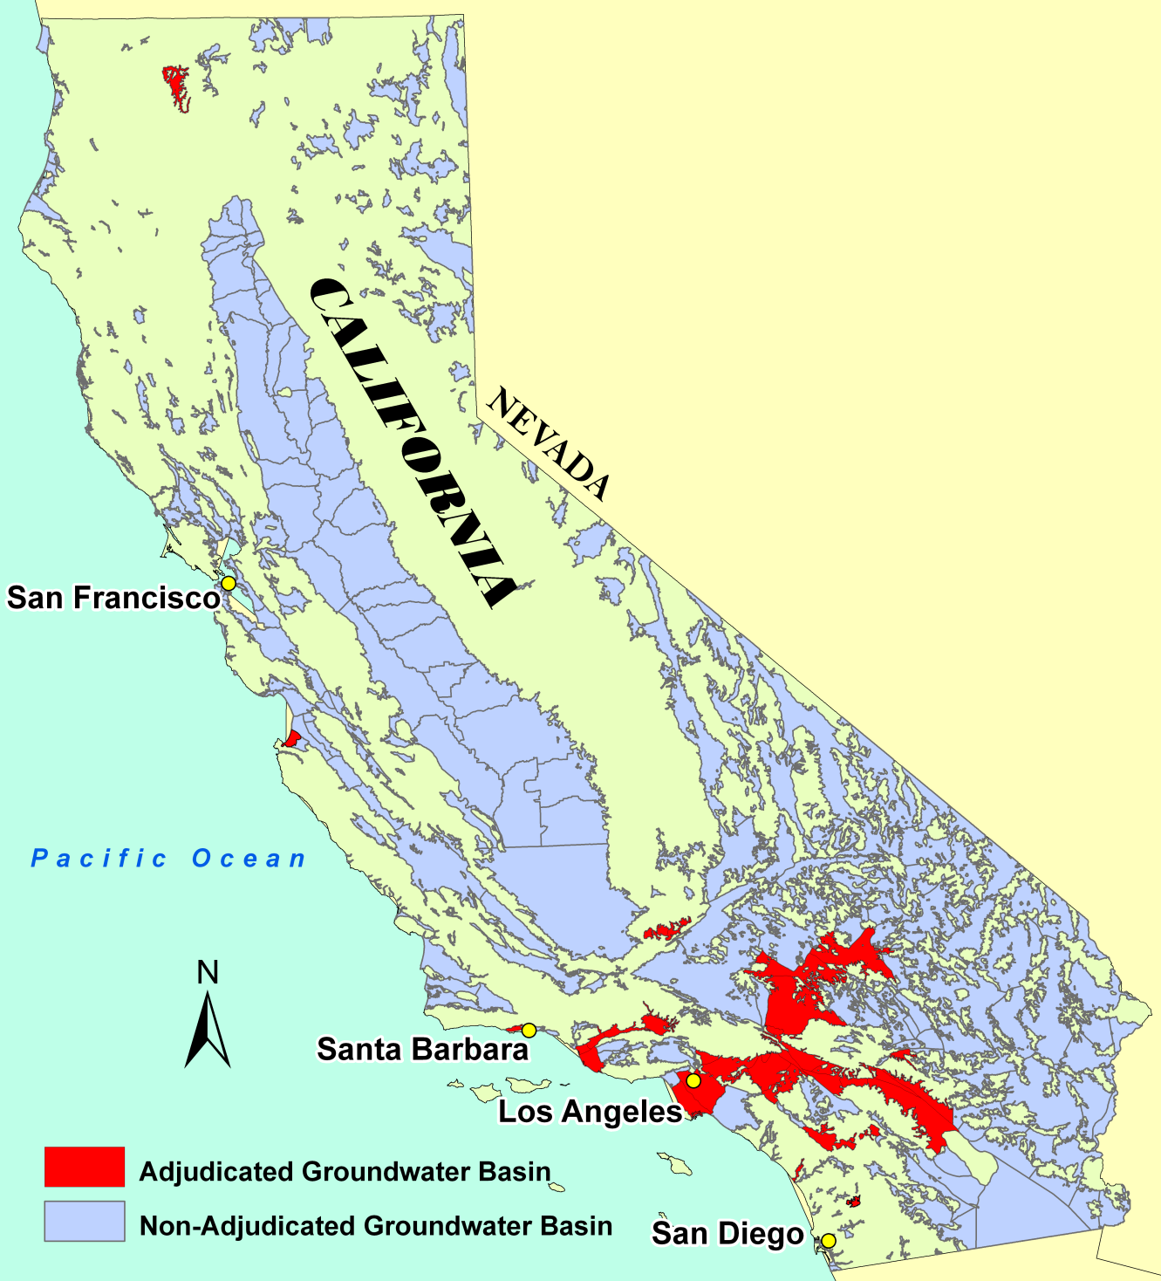
Notes:
Because of these challenges, adjudication has only occurred in 22 of California’s 512 groundwater basins, shown here.
In basins where adjudication does occur, the amount of rights that the court allocated to each user may not match those users’ demands as they change over time. Some users may be allocated more rights than they need, and other users may not be allocated as many rights as they want. To resolve this allocation imbalance, users can trade their groundwater pumping rights. In some adjudicated basins, this type of trading is occurring through coffee shop deals in which negotiations are conducted individually and on an ad hoc basis. However, these informal markets can be very inefficient.

Slide 13
Actual example from the Mojave Groundwater Basin, 2007-2008 Water Year
Notes:
Here is an actual example of informal market inefficiency from the Mojave Groundwater Basin in 2007-2008. ***User A pumped 40 acre-feet of groundwater more than his court-allocated rights allowed. An acre-foot of water is almost 326,000 gallons, or enough to fill half of an Olympic swimming pool. Since User A over-pumped, he paid $11,080 in over-extraction fees to the Mojave Water Agency, and the agency had to obtain replacement water from the State Water Project, which has all the negative effects associated with imported water.
In the same time period, ***User B had 52 acre-feet of water rights left unused. User A could have purchased those 40 AF of water rights from user B and potentially saved thousands of dollars. Assuming User B sells this 40 AF at the average lease price for that year’s market, she could have generated $8,000 in revenue.

Slide 14

Lack of information
High transaction costs
No marketplace
Opportunity for Improvement!
Notes:
As you can see by this typical example of existing market inefficiency, rights holders may not engage in transactions that would be mutually beneficial. There are two main reasons for this: ***First, There is a lack of market information. Not all water users may understand that there is a possibility of transferring their water rights, and they may not know what a reasonable price for water in their area is. ***Second, It may be difficult or time-consuming to locate interested buyers or sellers and then haggle over price. ***These factors make for high transaction costs, so it is difficult for informal markets to operate efficiently.
But, there is a significant opportunity for to reduce the inefficiencies in existing groundwater rights markets, and this is where Progressive Water Solutions comes in. We have designed innovative market solutions to facilitate the reallocation of rights among groundwater users and improve groundwater management

Slide 15


H₂O Exchange
Brokerage
Consulting
Better
Groundwater Management
Reduced
Environmental
Impact
Profits
Notes:
As an Eco-entrepreneurship group here at the Bren School, we created a 2-part business plan that addresses the need for better groundwater use and management in CA: The first part is a brokerage service called the H2O Exchange in which water users can buy, sell, or lease rights to pump groundwater. The second part is a consulting service that will help groundwater basins establish formal markets for groundwater rights transfers. These services will facilitate more efficient use and better management of groundwater resources, reduced environmental impact of water use, and profits for our business. I’ll explain the brokerage part of our business first…

Slide 16

PWS H₂O Exchange
What is the H₂O Exchange?
The H₂O Exchange connects groundwater rights holders who want to lease or sell their water rights with people that want to buy water in the same groundwater basin. The H₂O Exchange has active markets in the following basins:
    Mojave
    Santa Paula
If your basin is not listed above, please contact us to see how PWS LLC can be of service to you.
For specific information about how the H₂O Exchange market works please see Market Rules
LOGIN
User Name
Gary Libecap
Password
***********
Create an account
PWS
Home
PWS
My Account
PWS
Sell Water
PWS
Buy Water
PWS
Contact
PWS
Market Results
PWS
Market Rules
Notes:
Our H2O Exchange is an online groundwater market clearinghouse which is simple, transparent, and easy to use. It provides a centralized exchange where basin water users can go to trade groundwater rights. It will reduce the transaction costs associated with finding a trading partner, and reduce the need for price negotiation and excessive paperwork. This is the home page of the H2O Exchange website.

Slide 17
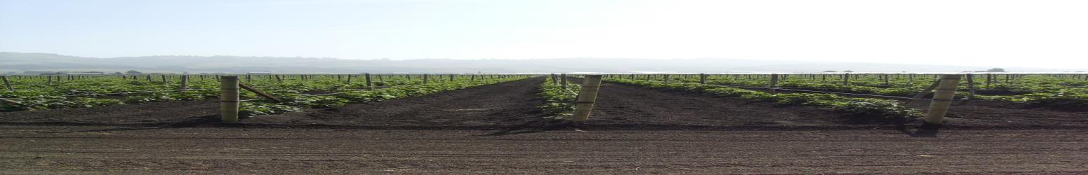
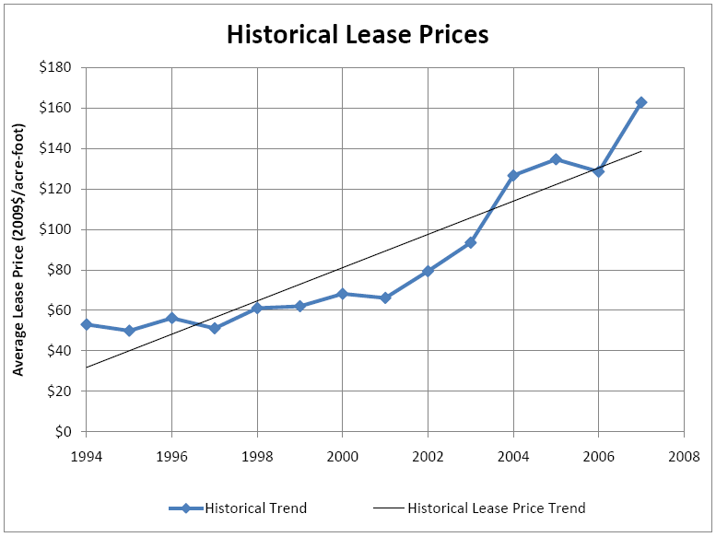
Buy Water
Water Bid
Volume (acre-feet)
100
Price ($/acre-foot)
$345
Term (select one)
1 year
Submit
PWS
Home
PWS
My Account
PWS
Sell Water
PWS
Buy Water
PWS
Contact
PWS
Market Results
PWS
Market Rules
Notes:
Water users register with us, then will be able to easily participate in the market with simple order entry screens. They will enter the ***quantity, ***price, and ***term of their desired transfer. The terms can be short-term 1-year leases, multi-year long-term leases, or permanent sales. Participants will be provided with relevant historical market information to inform their decisions.

Slide 18
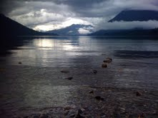
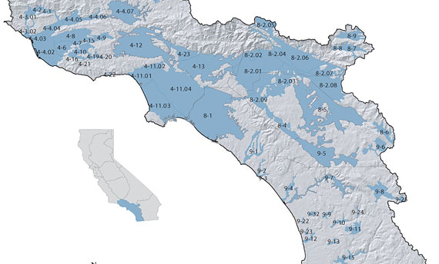
Market Results
Summary
Santa Paula Basin
Date
Jan 2, 2010
Market Price ($/AF)
$338.00
Market Volume (AF)
988
PWS
Home
PWS
My Account
PWS
Sell Water
PWS
Buy Water
PWS
Contact
PWS
Market Results
PWS
Market Rules
Notes:
Participants will be able to view the market results online after the exchange has concluded.

Slide 19
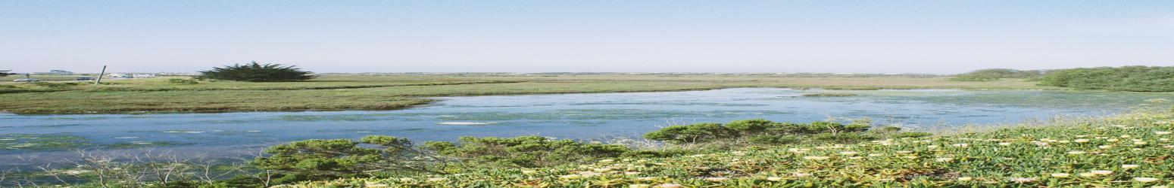

My Account
My Groundwater Basin
Santa Paula
Permanent Groundwater Right
1,200 acre-feet
Total 2010 Leased Groundwater
100 acre-feet
History of Trades
Date of Transaction | Term | Action | Volume (AF) | Price ($/AF) | Transaction total ($)
Jan 2, 2010 | 1yr | Bought | 100 | $338.00 | $34,476.00
Jan 2, 2009 | 1yr | Bought | 100 | $300.00 | $30,600.00
PWS
Home
PWS
My Account
PWS
Sell Water
PWS
Buy Water
PWS
Contact
PWS
Market Results
PWS
Market Rules
Notes:
Users will be able to view their account information and see exactly how much water they hold rights or leases to at any time, the amount of gw rights they have transferred during each market run, the price per acre-foot, and the total price of their transaction. In addition, ***the rules governing the structure of the market will be available at all times. Now that we have seen the easy-to-use public interface of the H2O Exchange, let’s take a look at what we are doing behind the scenes.

Slide 20

Notes:
When we announce that the market period is open, buyers and sellers post their bids online. Here the buyers’ bids are the red points, and the sellers’ asks are the blue points. These posts are based on actual data from the Santa Paula Groundwater Basin.

Slide 28
Clearinghouse Price
$338/acre-foot
Trading Volume
988 acre-feet
Notes:
Once the market period closes and all the user posts are in, our market algorithm goes to work. The algorithm calculates the ***market demand curve from all the buyer posts and the ***market supply curve from all the seller posts. We are most interested in the ***intersection of the demand and supply curves. The intersection tells us the ***price per acre-foot that will clear the market (in this case $338/AF), and the total ***quantity of gw rights that will be transferred for that market period (988 AF).

Slide 29
Notes:
Next, the algorithm determines which buyers and sellers are eligible to trade. ***All buyers who bid the market clearing price of $338/AF or more are eligible…

Slide 30
Notes:
shown here as the red points above the dashed green line. All sellers who asked for the market clearing price or less are eligible…

Slide 31
Notes:
shown here as the blue points below the green line. This way, no buyer has to pay more per AF than the price they bid, and will often pay less, and no seller has to receive less than the price per AF that they asked for, and will often receive more.

Slide 32
Notes:
Finally, the algorithm ***matches up buyers with sellers. We then notify market participants of the results, notify the Watermaster, submit all the appropriate transfer paperwork, and collect our brokerage fee from participants.PWS will run the market once every year, or more frequently if basin users request so. We’ll also run separate markets for permanent rights sales, multi-year leases, and annual leases. This way, basin users will have plenty of opportunities to trade their pumping rights if their gw needs change over time.

Slide 33
Trust
Every Basin is Different
Concentration of Pumping
Notes:
In order implement this H2O Exchange there are several issues we must address:
We must first gain trust of local water users. To accomplish this, our market will be completely voluntary, so no one who does not wish to participate will have to. Also, our process is transparent—we will publish historical transfer information and all H2O Exchange results on the website and our market rules are always available. Finally, as an independent third party we will not have been involved in previous water disputes.
Through our extensive research on adjudicated and non-adjudicated basins and the relationships we are forming with water management agencies, we recognize that every basin is different. Legal peculiarities within each basin are unique and may require specialized market design. The structure of our market is flexible so we can customize the H2O Exchange to each basin.
Finally, we need to avoid the concentration of pumping, both geographically and economically. If users in a small area are doing most of the groundwater pumping, the adverse effects of overdraft can occur in that localized area. We can work closely with Watermasters and adjust our market structure so that geographical concentration of pumping is avoided. Furthermore, since the H2O Exchange produces a single clearinghouse price instead of many prices, that should reduce economic concentration of pumping, or the ability of a single user or group of users to dominate the market.
So that is the PWS brokerage service and innovative H2O Exchange. Now Zoe will discuss the various benefits the H2O Exchange provides, describe the PWS consulting service, and outline our business model.

Slide 34

Brokerage

Slide 35
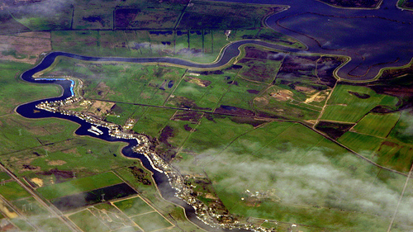

Who Benefits?
users who conserve
over-extractors
water managers
PWS
under-extractors
California’s environment
Notes:
Efficiency and imports
Animation Order: Over, Under, conser, Water mana, env, PWS CAN WE CHANGE THIS EFFECT TOO? ADD ADJUDICATED BASINS TO ANIMATION
Water users who currently extract more than their rights allow will be able to lease or buy water rights to avoid fees for replacement water. In the mojave basin, Water users paid 8 million dollars in fees for over extraction. This money went toward obtaining replacement water from outside sources. It could have instead been kept within the basin with trades between water users.
Water users who currently extract less than their rights allow will be able to sell their unused rights for a profit. In the Mojave they should have been able to capture a large percentage of the 8 million dollars in fees.
Users who have the capability to conserve water by investing in efficient technology or changing crop types can profit from doing so. In addition, the price signal will help these usere make sound business decisions and can drive innovation in conservation technologies.
Water managers should benefit from decreased administrative paperwork and costs, reduced need to purchase imported water, and an improved political environment in the basin.
Unadjudicated basins will benefit. After value of our markets has been demonstrated we will consult with managers in unadjudicated basins so that our markets can be part of their judgement.
In this way we will help enable successful adjudications by providing a mechanism for easy transfer of rights once they are established. This can make the process of defining rights less contentious.
California’s environment will also benefit. The clear price for water will provides incentive for conjunctive use projects and enhanced recharge using recycled water. In addition to being more stable and consistent, local supply has fewer environmental impacts than most imported water sources. Local groundwater is far more energy efficient and requires less GHG emissions than imports. Reduced exports of water from and through the Delta ecosystem, with its associated environmental impact. Opportunity for purchase of water by conservation groups.
EASY to implement, ready to do this now (: Works within California’s existing water policy and law

Slide 36
Consulting

Slide 37
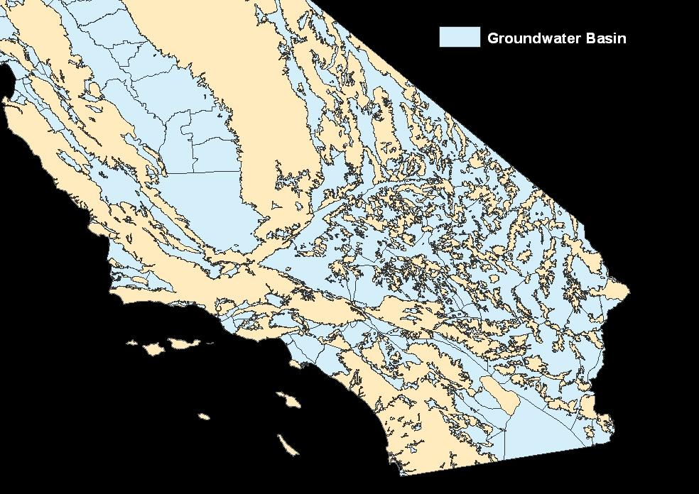
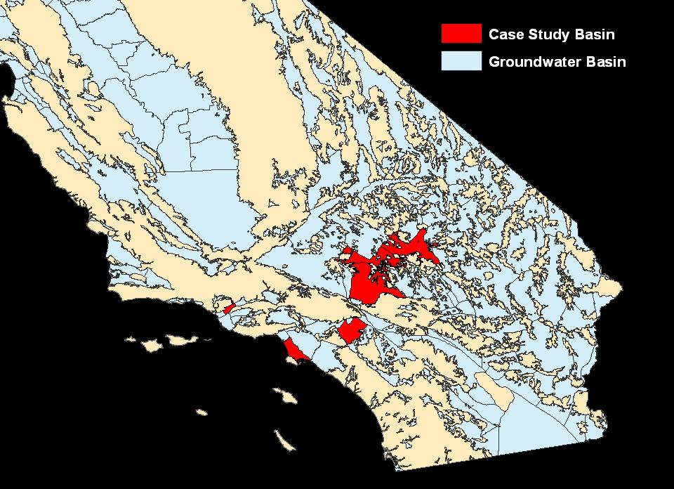
Mojave Basin
Santa Paula Basin
Chino Basin
West Coast Basin

Slide 38
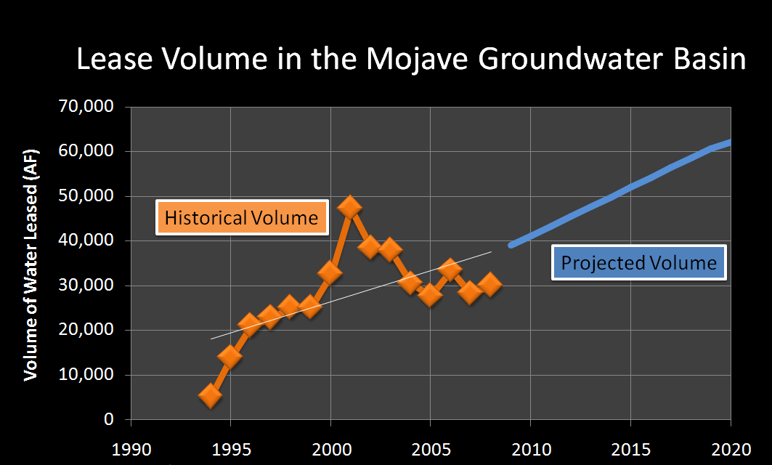

Notes:
Inrease due to H2O exchange (slope of line based on inefficiencies reduced-save for questions?)
SUGGEST REMOVING TRENDLINE FROM LEGEND

Slide 39
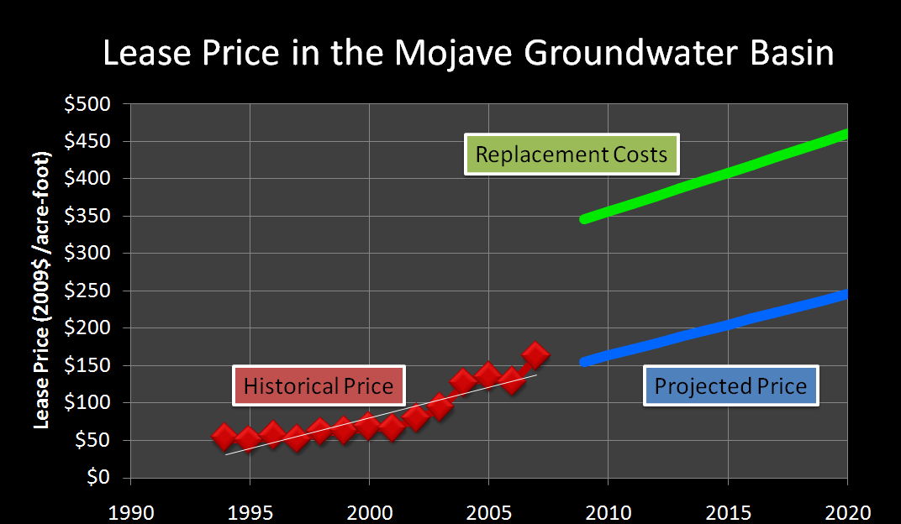
Notes:
Replacement water

Slide 40
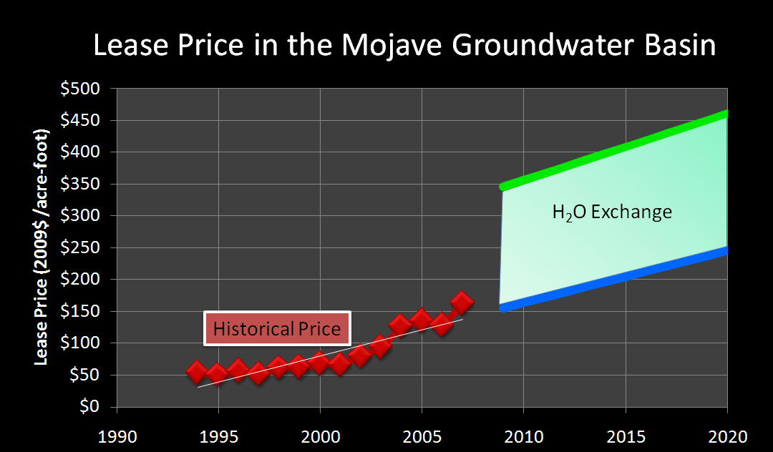
Notes:
Replacement water

Slide 41

Lease Value in the Mojave Groundwater Basin
Notes:
Talk about less tangible, conflict value

Slide 42






Market Characterization
Rights Holders
Water Rights
Expected Revenue
Small
Market
(Santa Paula)
Medium
Market
(West Coast)
Large
Market
(Mojave)
Notes:
We determined that three of our case study basins would support the H2O Exchange based on the number of rights holders who could participate, the volume of water available for trade, and the legal structure in the basin.
There are nine other adjudicated basins in California with characteristics similar to these three case study basins. Using the data we obtained from these three case study basins we projected our revenue in all twelve potential markets.
By 2020 we will have implemented the H2O Exchange in all of these basins, as well as consulted and implemented the Exchange in two currently non-adjudicated basins.

Slide 43

Volume Price 2% Fee
Consulting Fee
Revenue

Slide 44
PWS Revenue
Revenue
Cost

Slide 45
PWS Net Income
$3,830,000

Slide 46
“Whiskey is for drinking; water is for fighting over.”
“Whiskey is for drinking; water is for fighting over.”
trading!

Slide 47
We now welcome your comments and questions
Special thanks to:
Gary Libecap, Russ McGlothlin, Bob Wilkinson, Chris Coburn, Arianne Rettinger, Eco Entrepreneurship Advisory Council, Mary Bannister, Pajaro Valley Water Management Agency, Mojave Water Agency, Santa Paula Pumpers Association, West Coast Basin Watermaster, Chino Basin Watermaster, Benjamin Utley, Zack Donohew, Chris Costello, Laura Grant, Matt Kotchen, Loretta Tam, and Ainsley Close.

